Slide 1
UNDERSTANDING STATISTICS & EXPERIMENTAL DESIGN

Slide 2
Content
Basic Probability Theory
Signal Detection Theory (SDT)
SDT and Statistics I and II
Statistics in a nutshell
Multiple Testing
ANOVA
Experimental Design & Statistics
Correlations & PCA
Meta-Statistics: Basics
Meta-Statistics: Too good to be true
Meta-Statistics: How big a problem is publication bias?
Meta-Statistics: What do we do now?
Notes:
Not for book ppt

Slide 3
Replication and hypothesis testing

Slide 4
Experimental Methods
Suppose you hear about two sets of experiments that investigate phenomena A and B
Which effect is more believable?
 | Effect A | Effect B
Number of experiments | 10 | 19
Number of experiments that reject H₀ | 9 | 10
Replication rate | 0.9 | 0.53

Slide 5
Replication
Effect A is Bem’s (2011) precognition study that reported evidence of people’s ability get information from the future
I do not know any scientist who believes this effect is real
Effect B is from a meta-analysis of the bystander effect, where people tend to not help someone in need if others are around
I do not know any scientist who does not believe this is a real effect
So why are we running experiments?
 | Effect A | Effect B
Number of experiments | 10 | 19
Number of experiments that reject H₀ | 9 | 10
Replication rate | 0.9 | 0.53

Slide 6
Replication
Replication has long been believed to be the final arbiter of phenomena in science
But it seems to not work
Not sufficient (Bem, 2011)
Not necessary (bystander effect)
In a field that depends on hypothesis testing, like experimental psychology, some effects should be rejected because they are so frequently replicated

Slide 7
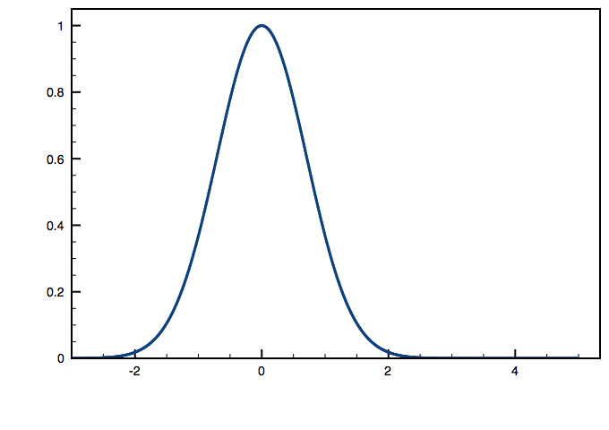
Hypothesis Testing (For Means)
We start with a null hypothesis: no effect, H₀
Identify a sampling distribution that describes variability in a test statistic

Slide 8
Hypothesis Testing (For Two Means)
We can identify rare test statistic values as those in the tail of the sampling distribution
If we get a test statistic in either tail, we say it is so rare (usually 0.05) that we should consider the null hypothesis to be unlikely
We reject the null

Slide 9
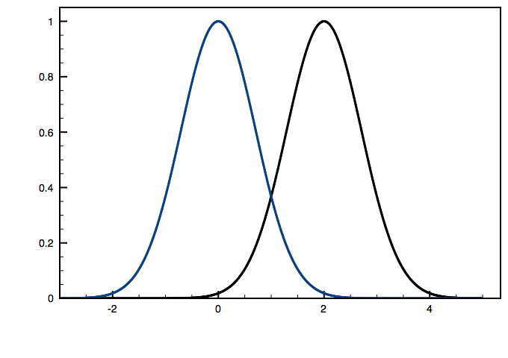
Alternative Hypothesis
If the null hypothesis is not true, then the data came from some other sampling distribution (H₁)

Slide 10
Power
If the alternative hypothesis is true
Power is the probability you will reject H₀
If you repeated the experiment many times, you would expect to reject H₀ with a proportion that reflects the power

Slide 11
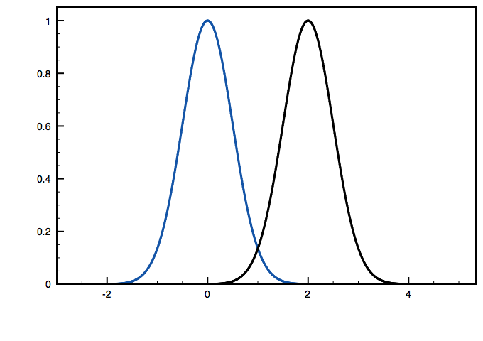
Power and sample size
The standard deviation of the sampling distribution is inversely related to the (square root of the) sample size
Power increases with larger sample sizes

Slide 12
Effect Size
The difference between the null and alternative hypotheses can be characterized by a standardized effect size

Slide 13
Effect Size
Effect size does not vary with sample size
although the estimate may become more accurate with larger samples

Slide 14
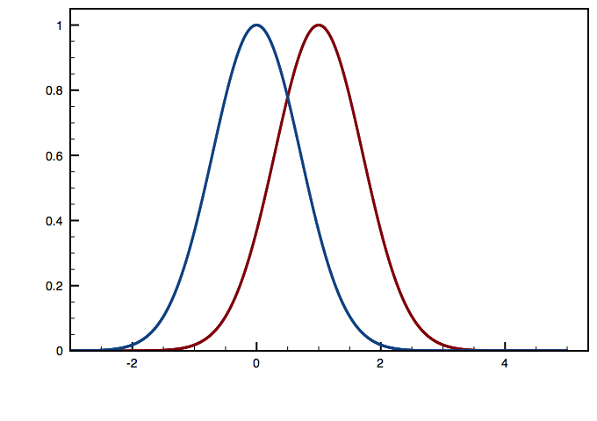
Effect size and power
Experiments with smaller effect sizes have smaller power

Slide 15
Effect size
Consider the 10 findings reported by Bem (2011)
All experiments were measured as a one-sample t-test (one tail, Type I error rate of 0.05)
For each experiment, we can measure the standardized effect size (Hedges g)
Where c(m) is a correction for small samples sizes (≈1)
s is the sample standard deviation, is the sample mean
μ₀ is the value in the null hypothesis

Slide 16
Effect size
Use meta-analytic techniques to pool the effect sizes across all ten experiments (Hedges & Olkin, 1985)
Pooled effect size
g*=0.1855
 | Sample size | Effect size (g)
Exp. 1 | 100 | 0.249
Exp. 2 | 150 | 0.194
Exp. 3 | 97 | 0.248
Exp. 4 | 99 | 0.202
Exp. 5 | 100 | 0.221
Exp. 6 Negative | 150 | 0.146
Exp. 6 Erotic | 150 | 0.144
Exp. 7 | 200 | 0.092
Exp. 8 | 100 | 0.191
Exp. 9 | 50 | 0.412
w_{i} is the inverse variance of the effect size estimate

Slide 17
Power
Use the pooled effect size to compute the power of each experiment (probability this experiment would reject the null hypothesis)
Pooled effect size
g*=0.1855
 | Sample size | Effect size (g) | Power
Exp. 1 | 100 | 0.249 | 0.578
Exp. 2 | 150 | 0.194 | 0.731
Exp. 3 | 97 | 0.248 | 0.567
Exp. 4 | 99 | 0.202 | 0.575
Exp. 5 | 100 | 0.221 | 0.578
Exp. 6 Negative | 150 | 0.146 | 0.731
Exp. 6 Erotic | 150 | 0.144 | 0.731
Exp. 7 | 200 | 0.092 | 0.834
Exp. 8 | 100 | 0.191 | 0.578
Exp. 9 | 50 | 0.412 | 0.363

Slide 18
Power
The sum of the power values (E=6.27) is the expected number of times experiments like these would reject the null hypothesis (Ioannidis & Trikalinos, 2007)
But Bem (2011) rejected the null O=9 out of 10 times!
 | Sample size | Effect size (g) | Power
Exp. 1 | 100 | 0.249 | 0.578
Exp. 2 | 150 | 0.194 | 0.731
Exp. 3 | 97 | 0.248 | 0.567
Exp. 4 | 99 | 0.202 | 0.575
Exp. 5 | 100 | 0.221 | 0.578
Exp. 6 Negative | 150 | 0.146 | 0.731
Exp. 6 Erotic | 150 | 0.144 | 0.731
Exp. 7 | 200 | 0.092 | 0.834
Exp. 8 | 100 | 0.191 | 0.578
Exp. 9 | 50 | 0.412 | 0.363

Slide 19
Bias Test
Use an exact test to consider the probability that any O=9 out of the 10 experiments would reject H₀
There are 11 such combinations
of the experiments
Their summed probability is only 0.058
A criterion threshold for a bias test is usually 0.1 (Begg & Mazumdar, 1994; Ioannidis & Trikalinos, 2007; Stern & Egger, 2001)
 | Sample size | Effect size (g) | Power
Exp. 1 | 100 | 0.249 | 0.578
Exp. 2 | 150 | 0.194 | 0.731
Exp. 3 | 97 | 0.248 | 0.567
Exp. 4 | 99 | 0.202 | 0.575
Exp. 5 | 100 | 0.221 | 0.578
Exp. 6 Negative | 150 | 0.146 | 0.731
Exp. 6 Erotic | 150 | 0.144 | 0.731
Exp. 7 | 200 | 0.092 | 0.834
Exp. 8 | 100 | 0.191 | 0.578
Exp. 9 | 50 | 0.412 | 0.363

Slide 20
Interpretation
The number of times Bem (2011) rejected the H₀ is inconsistent with the size of the reported effect and the properties of the experiments
Perhaps there were additional experiments that failed to reject H₀ but were not reported
Perhaps the experiments were run incorrectly in a way that rejected the H₀ too frequently
Perhaps the experiments were run incorrectly in a way that underestimated the true magnitude of the effect size
The findings in Bem (2011) seem too good to be true
Non-scientific set of findings
Anecdotal
Note, the effect may be true (or not), but the studies in Bem (2011) give no guidance

Slide 21
Bystander Effect
Fischer et al. (2011) described a meta-analysis of studies of the bystander effect
Broke down studies according to emergency or non-emergency situations

Slide 22
Bystander Effect
No suspicion of publication bias for non-emergency situations
Effect “B” from the earlier slides
Clear indication of publication bias for emergency situations
Even though fewer than half of the experiments reject H₀
 | Emergency situation | Non-emergency situation
Number of studies | 65 | 19
Pooled effect size | -0.30 | -0.47
Observed number of rejections of H₀ consistent with bystander effect (O) | 24 | 10
Expected number of rejections of H₀ consistent with bystander effect (E) | 10.02 | 10.77
χ²(1) | 23.05 | 0.128
p | <.0001 | 0.721

Slide 23
Simulated Replications
Two-sample t test
Control group: draw n₁ samples from a normal distribution N(0,1)
Experimental group: drawn n₂=n₁ samples from a normal distribution N(0.3,1)
The true effect size is 0.3
Repeat for 20 experiments
With random sample sizes n₂=n₁ drawn uniformly from [15, 50]

Slide 24
Simulated Replications
Compute the pooled effect size
g*=0.303
Very close to true 0.3
n₁=n₂ | t | Effect size | Power from true ES | Power from pooled ES | Power from biased ES
29 | 0.888 | 0.230 | 0.202 | 0.206
25 | 1.380 | 0.384 | 0.180 | 0.183
26 | 1.240 | 0.339 | 0.186 | 0.189
15 | 0.887 | 0.315 | 0.125 | 0.126
42 | 0.716 | 0.155 | 0.274 | 0.279
37 | 1.960 | 0.451 | 0.247 | 0.251
49 | -0.447 | -0.090 | 0.312 | 0.318
17 | 1.853 | 0.621 | 0.136 | 0.138
36 | 2.036 | 0.475 | 0.241 | 0.245 | 0.718
22 | 1.775 | 0.526 | 0.163 | 0.166
39 | 1.263 | 0.283 | 0.258 | 0.262
19 | 3.048 | 0.968 | 0.147 | 0.149 | 0.444
18 | 2.065 | 0.673 | 0.141 | 0.143 | 0.424
26 | -1.553 | -0.424 | 0.186 | 0.189
38 | -0.177 | -0.040 | 0.252 | 0.257
42 | 2.803 | 0.606 | 0.274 | 0.279 | 0.784
21 | 1.923 | 0.582 | 0.158 | 0.160
40 | 2.415 | 0.535 | 0.263 | 0.268 | 0.764
22 | 1.786 | 0.529 | 0.163 | 0.166
35 | -0.421 | -0.100 | 0.236 | 0.240

Slide 25
Simulated Replications
Compute the pooled effect size
g*=0.303
Very close to true 0.3
Use effect size to compute power
Sum of power is expected number of times to reject
E(true)=4.140
E(pooled)=4.214
Observed rejections
O=5
n₁=n₂ | t | Effect size | Power from true ES | Power from pooled ES | Power from biased ES
29 | 0.888 | 0.230 | 0.202 | 0.206
25 | 1.380 | 0.384 | 0.180 | 0.183
26 | 1.240 | 0.339 | 0.186 | 0.189
15 | 0.887 | 0.315 | 0.125 | 0.126
42 | 0.716 | 0.155 | 0.274 | 0.279
37 | 1.960 | 0.451 | 0.247 | 0.251
49 | -0.447 | -0.090 | 0.312 | 0.318
17 | 1.853 | 0.621 | 0.136 | 0.138
36 | 2.036 | 0.475 | 0.241 | 0.245 | 0.718
22 | 1.775 | 0.526 | 0.163 | 0.166
39 | 1.263 | 0.283 | 0.258 | 0.262
19 | 3.048 | 0.968 | 0.147 | 0.149 | 0.444
18 | 2.065 | 0.673 | 0.141 | 0.143 | 0.424
26 | -1.553 | -0.424 | 0.186 | 0.189
38 | -0.177 | -0.040 | 0.252 | 0.257
42 | 2.803 | 0.606 | 0.274 | 0.279 | 0.784
21 | 1.923 | 0.582 | 0.158 | 0.160
40 | 2.415 | 0.535 | 0.263 | 0.268 | 0.764
22 | 1.786 | 0.529 | 0.163 | 0.166
35 | -0.421 | -0.100 | 0.236 | 0.240
Σ = 4.14 4.214

Slide 26
Simulated Replications
n₁=n₂ | t | Effect size | Power from true ES | Power from pooled ES | Power from biased ES
29 | 0.888 | 0.230 | 0.202 | 0.206
25 | 1.380 | 0.384 | 0.180 | 0.183
26 | 1.240 | 0.339 | 0.186 | 0.189
15 | 0.887 | 0.315 | 0.125 | 0.126
42 | 0.716 | 0.155 | 0.274 | 0.279
37 | 1.960 | 0.451 | 0.247 | 0.251
49 | -0.447 | -0.090 | 0.312 | 0.318
17 | 1.853 | 0.621 | 0.136 | 0.138
36 | 2.036 | 0.475 | 0.241 | 0.245 | 0.718
22 | 1.775 | 0.526 | 0.163 | 0.166
39 | 1.263 | 0.283 | 0.258 | 0.262
19 | 3.048 | 0.968 | 0.147 | 0.149 | 0.444
18 | 2.065 | 0.673 | 0.141 | 0.143 | 0.424
26 | -1.553 | -0.424 | 0.186 | 0.189
38 | -0.177 | -0.040 | 0.252 | 0.257
42 | 2.803 | 0.606 | 0.274 | 0.279 | 0.784
21 | 1.923 | 0.582 | 0.158 | 0.160
40 | 2.415 | 0.535 | 0.263 | 0.268 | 0.764
22 | 1.786 | 0.529 | 0.163 | 0.166
35 | -0.421 | -0.100 | 0.236 | 0.240
Probability of observing O≥5 rejections for 20 experiments like these is
0.407 for true ES
0.417 for pooled ES
No indication of publication bias when all the experiments are fully reported
Σ = 4.14 4.214

Slide 27
Simulated File Drawer
Suppose a researcher only published the experiments that rejected the null hypothesis
The pooled effect size is now
g*=0.607
Double the true effect!
Also increases the estimated power of the reported experiments
n₁=n₂ | t | Effect size | Power from true ES | Power from pooled ES | Power from biased ES
29 | 0.888 | 0.230 | 0.202 | 0.206
25 | 1.380 | 0.384 | 0.180 | 0.183
26 | 1.240 | 0.339 | 0.186 | 0.189
15 | 0.887 | 0.315 | 0.125 | 0.126
42 | 0.716 | 0.155 | 0.274 | 0.279
37 | 1.960 | 0.451 | 0.247 | 0.251
49 | -0.447 | -0.090 | 0.312 | 0.318
17 | 1.853 | 0.621 | 0.136 | 0.138
36 | 2.036 | 0.475 | 0.241 | 0.245 | 0.718
22 | 1.775 | 0.526 | 0.163 | 0.166
39 | 1.263 | 0.283 | 0.258 | 0.262
19 | 3.048 | 0.968 | 0.147 | 0.149 | 0.444
18 | 2.065 | 0.673 | 0.141 | 0.143 | 0.424
26 | -1.553 | -0.424 | 0.186 | 0.189
38 | -0.177 | -0.040 | 0.252 | 0.257
42 | 2.803 | 0.606 | 0.274 | 0.279 | 0.784
21 | 1.923 | 0.582 | 0.158 | 0.160
40 | 2.415 | 0.535 | 0.263 | 0.268 | 0.764
22 | 1.786 | 0.529 | 0.163 | 0.166
35 | -0.421 | -0.100 | 0.236 | 0.240
Σ = 4.14 4.214

Slide 28
Simulated File Drawer
The sum of power values is again the expected number of times the null hypothesis should be rejected
E(biased)=3.135
Compare to O=5
The probability of 5 experiments like these all rejecting the null is the product of the power terms
0.081 (<0.1)
Indicates publication bias
n₁=n₂ | t | Effect size | Power from true ES | Power from pooled ES | Power from biased ES
29 | 0.888 | 0.230 | 0.202 | 0.206
25 | 1.380 | 0.384 | 0.180 | 0.183
26 | 1.240 | 0.339 | 0.186 | 0.189
15 | 0.887 | 0.315 | 0.125 | 0.126
42 | 0.716 | 0.155 | 0.274 | 0.279
37 | 1.960 | 0.451 | 0.247 | 0.251
49 | -0.447 | -0.090 | 0.312 | 0.318
17 | 1.853 | 0.621 | 0.136 | 0.138
36 | 2.036 | 0.475 | 0.241 | 0.245 | 0.718
22 | 1.775 | 0.526 | 0.163 | 0.166
39 | 1.263 | 0.283 | 0.258 | 0.262
19 | 3.048 | 0.968 | 0.147 | 0.149 | 0.444
18 | 2.065 | 0.673 | 0.141 | 0.143 | 0.424
26 | -1.553 | -0.424 | 0.186 | 0.189
38 | -0.177 | -0.040 | 0.252 | 0.257
42 | 2.803 | 0.606 | 0.274 | 0.279 | 0.784
21 | 1.923 | 0.582 | 0.158 | 0.160
40 | 2.415 | 0.535 | 0.263 | 0.268 | 0.764
22 | 1.786 | 0.529 | 0.163 | 0.166
35 | -0.421 | -0.100 | 0.236 | 0.240
Σ = 4.14 4.214 3.135

Slide 29
Simulated File Drawer
The test for publication bias works properly
But it is conservative
If the test indicates bias, we can be fairly confident it is correct

Slide 30
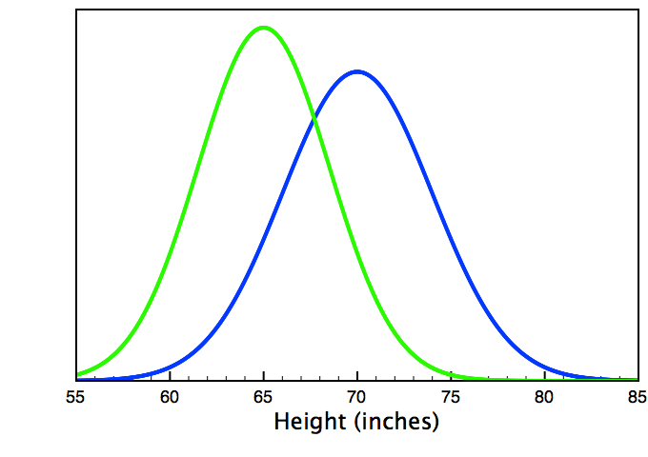
Statistical Errors
Even if an effect is truly zero, a random sample will sometimes produce a significant effect (false alarm: α)
Even if an effect is non-zero, a random sample will not always produce a statistically significant effect (miss: β=1-power)
A scientist who does not sometimes make a mistake with statistics is doing it wrong
There can be excess success
Women
Men

Slide 31
Simulated Optional Stopping
There are other types of biases
Set true effect size to 0
Optional stopping:
Take sample of n₁=n₂=15
Run hypothesis test
If reject null or n₁=n₂ =100, stop and report
Otherwise, add one more sample to each group and repeat
Just by random sampling, O=4 experiments reject the null hypothesis
Type I error rate of 0.2, even though used α=0.05
n₁=n₂ | t | Effect size | Power from pooled ES | Power from file drawer ES
19 | 2.393 | 0.760 | 0.053 | 0.227
100 | 0.774 | 0.109 | 0.066
100 | 1.008 | 0.142 | 0.066
63 | 2.088 | 0.370 | 0.060 | 0.611
100 | 0.587 | 0.083 | 0.066
100 | -1.381 | -0.195 | 0.066
100 | -0.481 | -0.068 | 0.066
100 | 0.359 | 0.051 | 0.066
100 | -1.777 | -0.250 | 0.066
100 | -0.563 | -0.079 | 0.066
100 | 1.013 | 0.143 | 0.066
100 | -0.012 | -0.002 | 0.066
46 | 2.084 | 0.431 | 0.057 | 0.480
100 | 0.973 | 0.137 | 0.066
100 | -0.954 | -0.134 | 0.066
100 | -0.136 | -0.019 | 0.066
78 | 2.052 | 0.327 | 0.062 | 0.704
100 | -0.289 | -0.041 | 0.066
100 | 1.579 | 0.222 | 0.066
100 | 0.194 | 0.027 | 0.066

Slide 32
Simulated Optional Stopping
n₁=n₂ | t | Effect size | Power from pooled ES | Power from file drawer ES
19 | 2.393 | 0.760 | 0.053 | 0.227
100 | 0.774 | 0.109 | 0.066
100 | 1.008 | 0.142 | 0.066
63 | 2.088 | 0.370 | 0.060 | 0.611
100 | 0.587 | 0.083 | 0.066
100 | -1.381 | -0.195 | 0.066
100 | -0.481 | -0.068 | 0.066
100 | 0.359 | 0.051 | 0.066
100 | -1.777 | -0.250 | 0.066
100 | -0.563 | -0.079 | 0.066
100 | 1.013 | 0.143 | 0.066
100 | -0.012 | -0.002 | 0.066
46 | 2.084 | 0.431 | 0.057 | 0.480
100 | 0.973 | 0.137 | 0.066
100 | -0.954 | -0.134 | 0.066
100 | -0.136 | -0.019 | 0.066
78 | 2.052 | 0.327 | 0.062 | 0.704
100 | -0.289 | -0.041 | 0.066
100 | 1.579 | 0.222 | 0.066
100 | 0.194 | 0.027 | 0.066
Pooled effect size across all experiments is g*=0.052
Sum of power values is E=1.28
Probability of O≥4 is 0.036
Σ = 1.28

Slide 33
Simulated Optional Stopping
Pooled effect size across all experiments is g*=0.052
Sum of power values is E=1.28
Probability of O≥4 is 0.036
If add a file-drawer bias
g*=0.402
E=2.02
P=0.047
n₁=n₂ | t | Effect size | Power from pooled ES | Power from file drawer ES
19 | 2.393 | 0.760 | 0.053 | 0.227
100 | 0.774 | 0.109 | 0.066
100 | 1.008 | 0.142 | 0.066
63 | 2.088 | 0.370 | 0.060 | 0.611
100 | 0.587 | 0.083 | 0.066
100 | -1.381 | -0.195 | 0.066
100 | -0.481 | -0.068 | 0.066
100 | 0.359 | 0.051 | 0.066
100 | -1.777 | -0.250 | 0.066
100 | -0.563 | -0.079 | 0.066
100 | 1.013 | 0.143 | 0.066
100 | -0.012 | -0.002 | 0.066
46 | 2.084 | 0.431 | 0.057 | 0.480
100 | 0.973 | 0.137 | 0.066
100 | -0.954 | -0.134 | 0.066
100 | -0.136 | -0.019 | 0.066
78 | 2.052 | 0.327 | 0.062 | 0.704
100 | -0.289 | -0.041 | 0.066
100 | 1.579 | 0.222 | 0.066
100 | 0.194 | 0.027 | 0.066
Σ = 1.28 2.02

Slide 34
Simulated Optional Stopping bias
The test for publication bias works properly
But it is conservative
When the test indicates bias, it is almost always correct

Slide 35
Data And Theory
Elliot, Niesta Kayser, Greitemeyer, Lichtenfeld, Gramzow, Maier & Liu (2010). Red, rank, and romance in women viewing men. Journal of Experimental Psychology: General
Picked up by the popular press

Slide 36
Data And Theory
7 successful experiments, three theoretical conclusions
1) Women perceive men to be more attractive when seen on a red background and in red clothing
2) Women perceive men to be more sexually desirable when seen on a red background and in red clothing
3) Changes in perceived status are responsible for these effects

Slide 37
Analysis: Attractiveness
Pooled effect size is
g*=0.785
Every reported experiment rejected the null
Given the power values, the expected number of rejections is E=2.86
The estimated probability of five experiments like these to all reject the null is 0.054
Description | N1 | N2 | Effect size | Power from pooled ES
Exp. 1 | 10 | 11 | 0.914 | .400
Exp. 2 | 20 | 12 | 1.089 | .562
Exp. 3 | 16 | 17 | 0.829 | .589
Exp. 4 | 27 | 28 | 0.54 | .816
Exp. 7 | 12 | 15 | 0.824 | .496

Slide 38
Analysis: Desirability
Pooled effect size is
g*=0.744
Every reported experiment rejected the null
The estimated probability of three experiments like these to all reject the null is 0.191
Description | N1 | N2 | Effect size | Power from pooled ES
Exp. 3 | 16 | 17 | 0.826 | .544
Exp. 4 | 27 | 28 | 0.598 | .773
Exp. 7 | 12 | 15 | 0.952 | .455

Slide 39
Analysis: Status
Pooled effect size is
g*=0.894
Every reported experiment rejected the null
The estimated probability of three experiments like these to all reject the null is 0.179
Description | N1 | N2 | Effect size | Power from pooled ES
Exp. 5a (present) | 10 | 10 | .929 | .395
Exp. 5a (potential) | 10 | 10 | 1.259
Exp. 6 | 19 | 18 | 0.718 | .752
Exp. 7 | 12 | 15 | 0.860 | .602

Slide 40
Future Studies
The probabilities for desirability and status do not fall below the 0.1 threshold
One more successful experimental result for these measures is likely to drop the power probability below the criterion
These results will be most believable if a replication fails to show a statistically significant result
But just barely fails
A convincing fail will have a small effect size, which will pull down the estimated power of the other studies

Slide 41
Theories From Data
Elliot et al. (2010) proposed a theory
Red influences perceived status, which then influences perceived attractiveness and desirability
Such a claim requires (at least) that all three results be valid
Several experiments measured these variables with a single set of subjects
The data on these measures are correlated
Total power is not just the product of probabilities
Can recalculate power with provided correlations among variables

Slide 42
Analysis: Correlated Data
Every reported test rejected the null
The estimated probability of 12 hypothesis tests in seven experiments like these to all reject the null is 0.005
Description | Power from pooled ES
Exp. 1, Attractiveness, desirability | .400
Exp. 2, Attractiveness | .562
Exp. 3, Attractiveness, desirability | .438
Exp. 4, Attractiveness, desirability | .702
Exp. 5a, Status | .395
Exp. 6 Status | .752
Exp. 7 Attractiveness, desirability, status | .237

Slide 43
Theories From Data
Elliot et al. (2010) proposed a theory
Red influences perceived status, which then influences perceived attractiveness and desirability
This theory also generated five predicted null findings
E.g., Men do not show the effect of perceived attractiveness when rating other men
If the null is true for these cases, the probability of all five tests not rejecting the null is
(1 – 0.05)⁵ = 0.77
The theory never made a mistake in predicting the outcome of a hypothesis test
The estimated probability of such an outcome is
0.005 x 0.77 = 0.0038

Slide 44
Response From Elliot & Maier (2013)
Lots of other labs have verified the red-attractiveness effect
If these other studies form part of the evidence for their theory, they only strengthen the claim of bias (which now includes other labs)
Conducted a replication study of Experiment 3
N₁=75 women judged attractiveness of men’s photos with red
N₂=69 women judged attractiveness of men’s photos with gray
Results: t= 1.51, p=.13, effect size = 0.25
They conclude that the effect is real, but smaller than they originally estimated
Implies that they do not believe in hypothesis testing.

Slide 45
Analysis: Attractiveness 2
Pooled effect size is
g*=0.785 0.532
Given the power values, the expected number of rejections is E=2.86 2.47
The estimated probability of five out of five six experiments like these to reject the null is 0.054 0.030
Description | N1 | N2 | Effect size | Power from pooled ES
Exp. 1 | 10 | 11 | 0.914 | .400 .212
Exp. 2 | 20 | 12 | 1.089 | .562 .297
Exp. 3 | 16 | 17 | 0.829 | .589 .316
Exp. 4 | 27 | 28 | 0.54 | .816 .491
Exp. 7 | 12 | 15 | 0.824 | .496 .262
Replication | 75 | 69 | 0.251 | .887

Slide 46
Analysis: Attractiveness 2’
One could argue that the best estimate of the effect is from the replication experiment
g*=0.785 0.532 0.251
Given the power values, the expected
number of rejections is E=2.86 2.47 0.860
The estimated probability of five out
of five six experiments like these to
reject the null is 0.054 0.030 0.0002
The estimated probability of the original
5 experiments all being successful is 0.000013
Description | N1 | N2 | Effect size | Power from pooled ES
Exp. 1 | 10 | 11 | 0.914 | .400 .212 .085
Exp. 2 | 20 | 12 | 1.089 | .562 .297 .103
Exp. 3 | 16 | 17 | 0.829 | .589 .316 .107
Exp. 4 | 27 | 28 | 0.54 | .816 .491 .149
Exp. 7 | 12 | 15 | 0.824 | .496 .262 .095
Replication | 75 | 69 | 0.251 | .887 .320

Slide 47
Analysis: Attractiveness 3
A recent meta-analysis (n=3,381) (Lehmann, Elliot, Calin-Jageman, 2018)
Finds small effect size (d=0.13)
Evidence of publication bias
Two conclusions sections:
First and Third Authors: “The simplest conclusion from our results is that the true effect of incidental red on attraction is very small, potentially nonexistent.”
Second Author: “Two primary weaknesses are that nearly all existing studies are underpowered and fail to attend to important color science procedures, especially regarding color production (e.g., spectral assessment, matching color attributes) and presentation (e.g., ambient illumination, background contrast; Elliot, 2015; Fairchild, 2015). Indeed, not a single published study that contributed to our main meta-analysis would be considered exemplary based on these two criteria alone.”

Slide 48
Power And Replication
Studies that depend on hypothesis testing can only detect a given effect with a certain probability
Due to random sampling
Even if the effect is true, you should sometimes fail to reject H₀
The frequency of rejecting H₀ must reflect the underlying power of the experiments
When the observed number of rejections is radically different from what is to be expected, something is wrong (publication bias, optional stopping, something else)

Slide 49
Good News
Many people get very concerned when their experimental finding is not replicated by someone else
Lots of accusations about incompetence and suppositions about who is wrong
But “failure” to replicate is expected when decisions are made with hypothesis testing
At a rate dependent on the experimental power
Statisticians have an obligation to be wrong the specified proportion of the time

Slide 50
Conclusions

Slide 51
Conclusions
For a scientist, low power comes with great responsibility
A scientist must resist the temptation to make the data show what they desire
A scientist must not keep gathering data until finding what he desires
A scientist must not try different analyses until finding one that shows what she wants.
A scientist must resist drawing firm conclusions from noisy data
Being a responsible scientist is easy when the signal is clear and noise is small (high power)
Statistics is easy with large power.

Slide 52
Take home messages

Slide 53
END Class 10

