Slide 1
Excess success in “Don’t count calorie labeling out: Calorie counts on the left side of menu items lead to lower calorie food choices
Greg Francis
PSY 392 Data Mining
20 November 2019

Slide 2
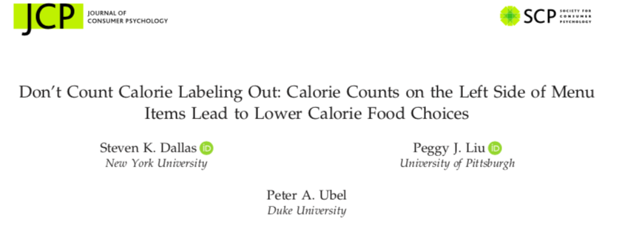

Slide 3
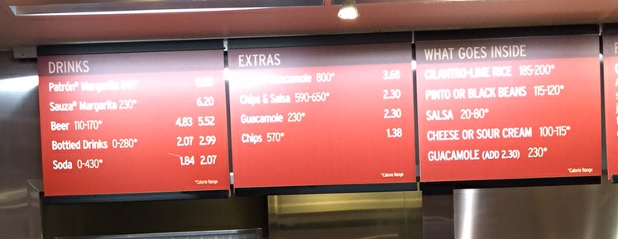
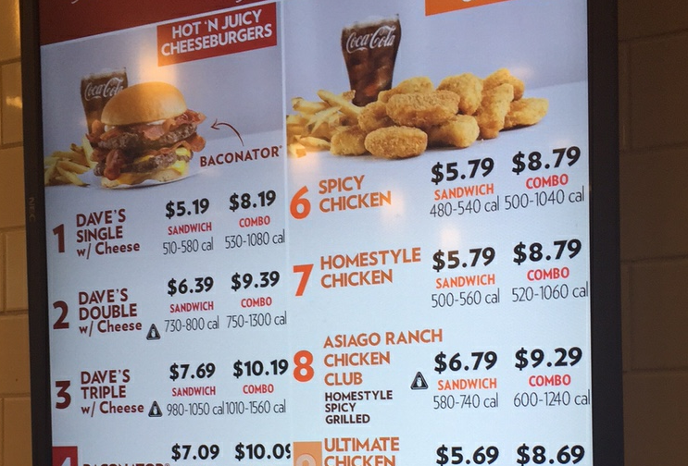
Obesity epidemic
New law to include calorie content on menus

Slide 4
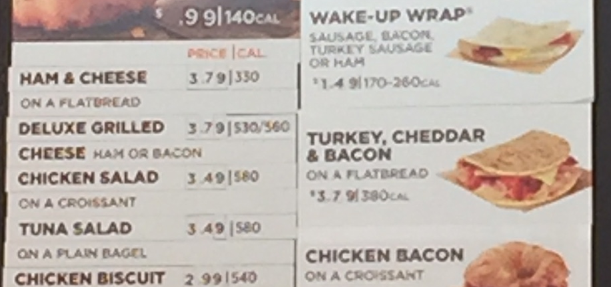
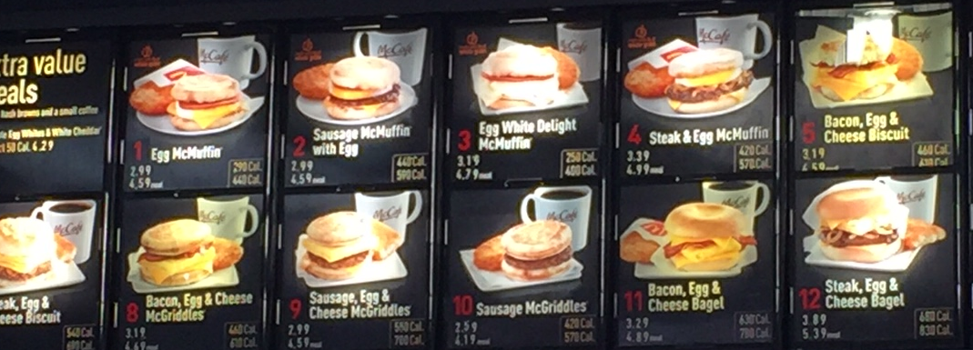
Obesity epidemic
Unfortunately, labels do not seem to work

Slide 5
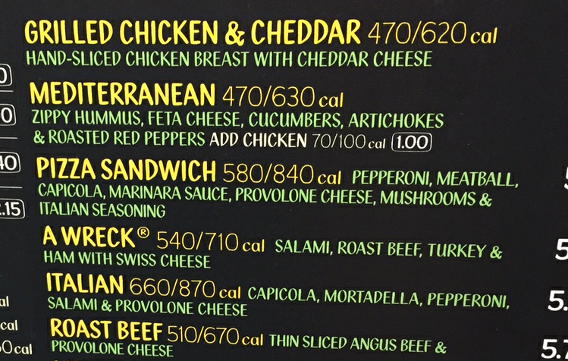
Label placement
Almost always to the right of item name/description

Slide 6
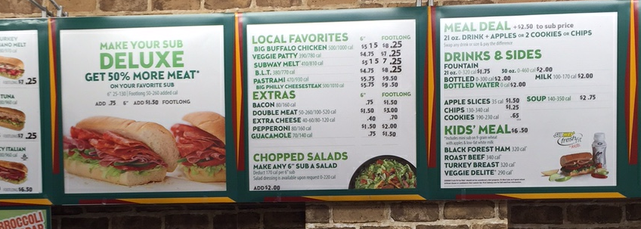
Label placement
We read from left to right, so calorie information is processed after item name/description
Placement may reduce the impact of the information
What if put calorie labels first?

Slide 7
Study 1
Make copies of a restaurant’s menu
Share with diners waiting in line
Ask them to circle the items they planned to order

Slide 8
No calorie labels

Slide 9
Labels on right

Slide 10
Labels on left

Slide 11
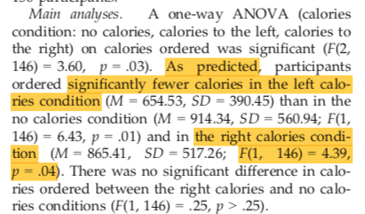
Study 1
Several tests, but we focus on the comparison of labels on the left vs. labels on the right

Slide 12
Study S1
Replication of Study 1

Slide 13
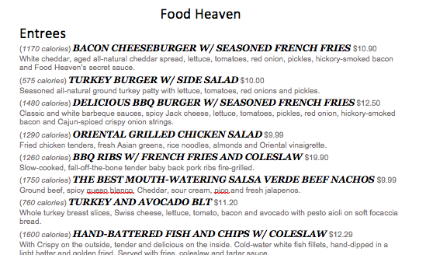
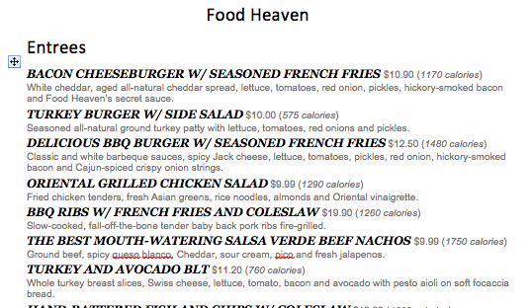
Study 2
Same idea, different menus, measure some additional details about processing order

Slide 14
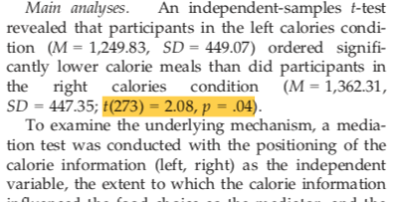
Study 2
Many results, but we focus on the difference between left and right calorie labels

Slide 15
Study S2
Replication of Study 2
Different menu and participants (Amazon Turk)

Slide 16
Study S3
A replication of Study S2, but with unlimited time for making food choice

Slide 17
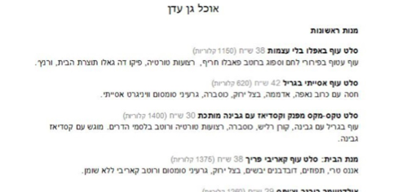
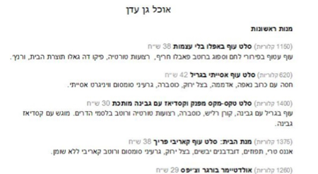
Study 3
Hebrew-speaking Israelis read from right to left
Calorie labels should have bigger impact when placed on the right

Slide 18
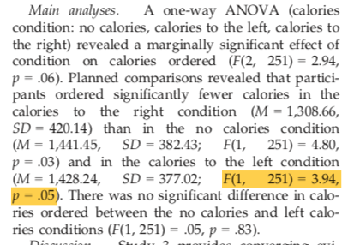
Study 3
Lots of tests, but we focus on the difference in food choices for calories on the left vs. on the right

Slide 19
Power
Each study is estimated to have a power only a little better than a coin flip
This is surely an overestimate because every study had additional successful significance tests
Study | Power
Study 1 | 0.548369
Study S1 | 0.5393026
Study 2 | 0.5448996
Study S2 | 0.5804973
Study S3 | 0.547353
Study 3 | 0.5069752

Slide 20
Excess success
The probability of six independent tests like these all rejecting the null hypothesis is the product of the power values
P_{TES}=0.026
The reported results seem “too good to be true”
Study | Power
Study 1 | 0.548369
Study S1 | 0.5393026
Study 2 | 0.5448996
Study S2 | 0.5804973
Study S3 | 0.547353
Study 3 | 0.5069752

Slide 21
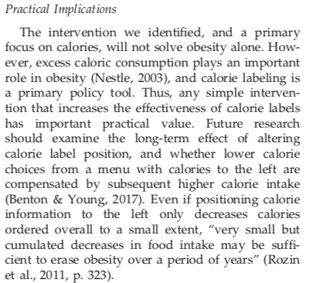
Implications
Any practical implications of the conclusions from Dallas, Liu & Ubel (2019) require the results to be believable
There may be an effect of calorie label placement, but their data does not establish the effect
Any effect is almost surely smaller than what they estimate

Slide 22
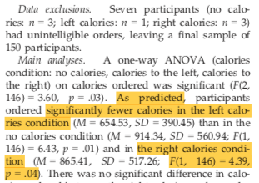
Other issues
Sloppy reporting of statistics
Study 1: wrong degrees of freedom for F-test
Should be N-K = 150 -3 = 147
StatCheck found one inconsistency, but it does not change any conclusions

Slide 23
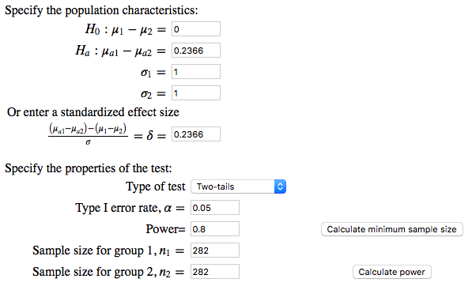
A better study
What would it take to properly investigate calorie label placement?
Consider a meta-analysis of the effect across the six reported experiments
We get g* = 0.2366
What sample size do we need to get 80% power for a test of two independent means?
https://introstatsonline.com/chapters/calculators/mean_two_sample_power.shtml

Slide 24
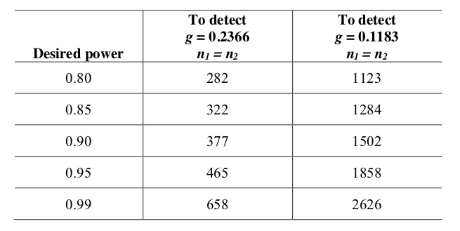
A better study
If you want more power, you need more subjects
The reported studies probably overestimate the effect, perhaps it is half as big as they suggest

Slide 25
Conclusions
Dallas, Liu & Ubel (2019)
An important topic
With practical implications
Clever experimental designs
Used 2292 subjects across 6 experiments
A waste of resources and time
The most optimistic outcome is that we learned the effect (if it exists) is tiny and probably not worth studying

